Slide 1
ROCKBUSTER STEALTH . ONLINE VIDEO SERVICE LAUNCH STRATEGY
Data Analysis & Recommendations
VÍCTOR A. GALLARDO

Slide 2
TABLE OF CONTENTS
INTRODUCTION & OBJECTIVES 03
KEY QUESTIONS 04
SUMMARY STATISTICS 05
QUESTION 1 06
QUESTION 1 07
QUESTION 2 08
QUESTION 3 & 4 09
QUESTION 5 10
INSIGHTS & RECOMMENDATIONS 11

Slide 3
INTRODUCTION & OBJECTIVES
Rockbuster Stealth LLC is planning to launch an online video service.
Our goal is to analyze the data to inform the launch strategy for this new service.
The Rockbuster Stealth management team has raised a number of key questions.

Slide 4
KEY QUESTIONS
● 1 Which movies contributed the most/least to revenue gain?
● 2 What was the average rental duration for all videos?
● 3 Which countries are Rockbuster customers based in?
● 4 Do sales figures vary between geographic regions?
● 5 Where are customers with a high lifetime value based?

Slide 5




SUMMARY STATISTICS
599
108
2 Stores
Customers
Countries
1000
5 days
Titles
Averge rental duration
61312.04$
102.35$
Total Revenue
Average revenue per customer

Slide 6
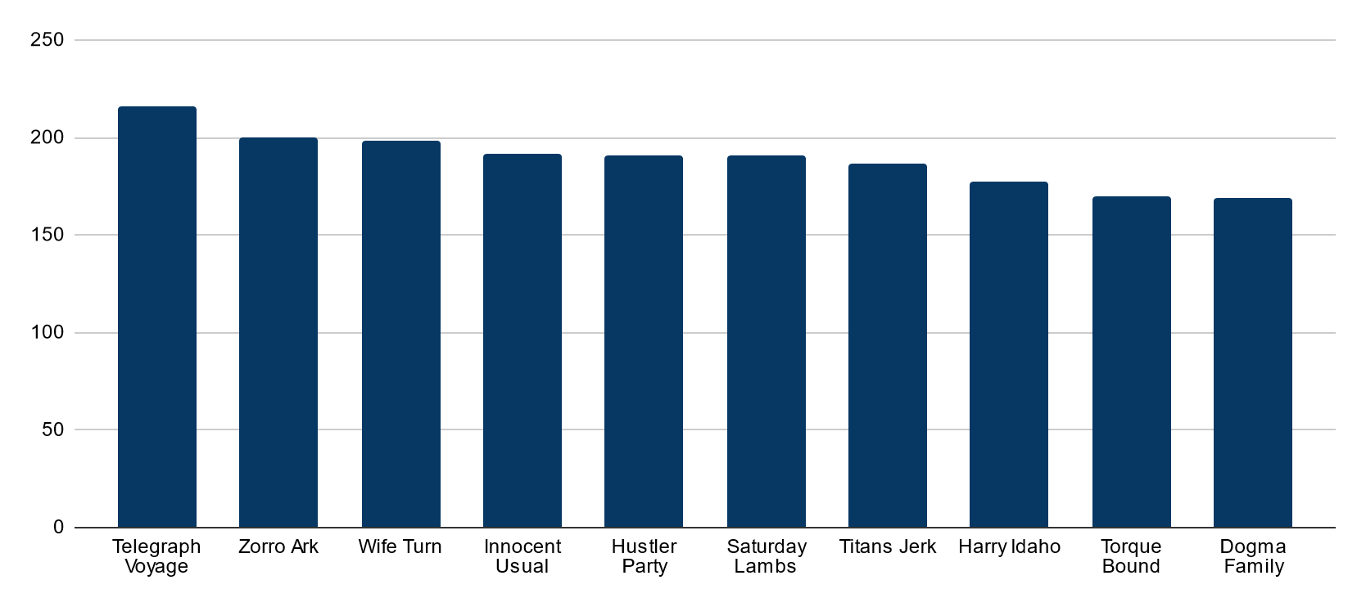
Which movies contributed the most/least to revenue gain?
1
TOP 10 MOVIES BY REVENUE

Slide 7
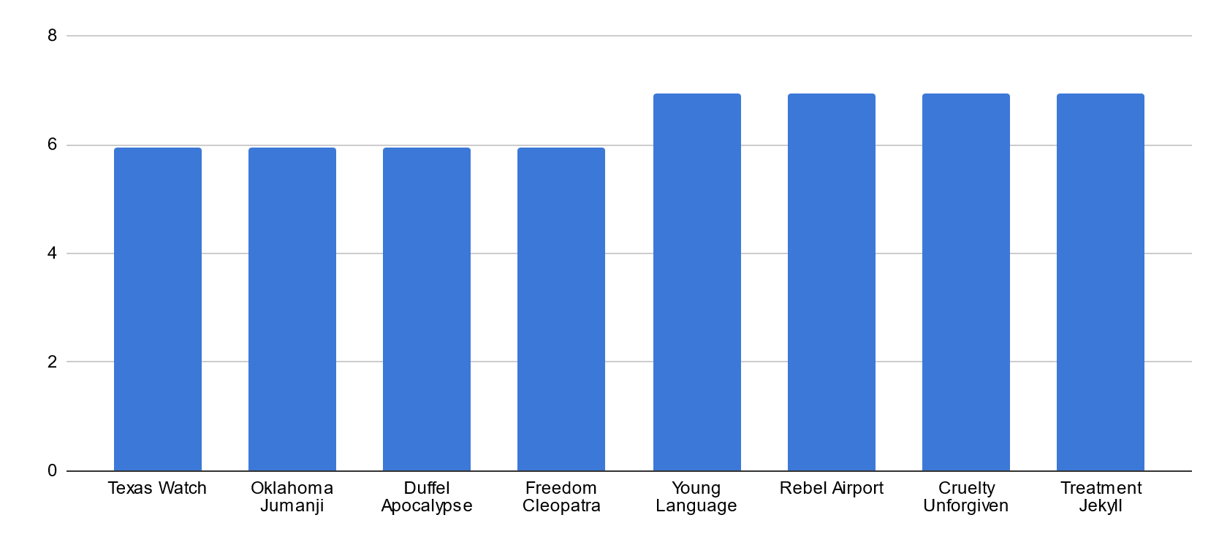
Which movies contributed the most/least to revenue gain?
1
BOTTOM 10 MOVIES BY REVENUE

Slide 8
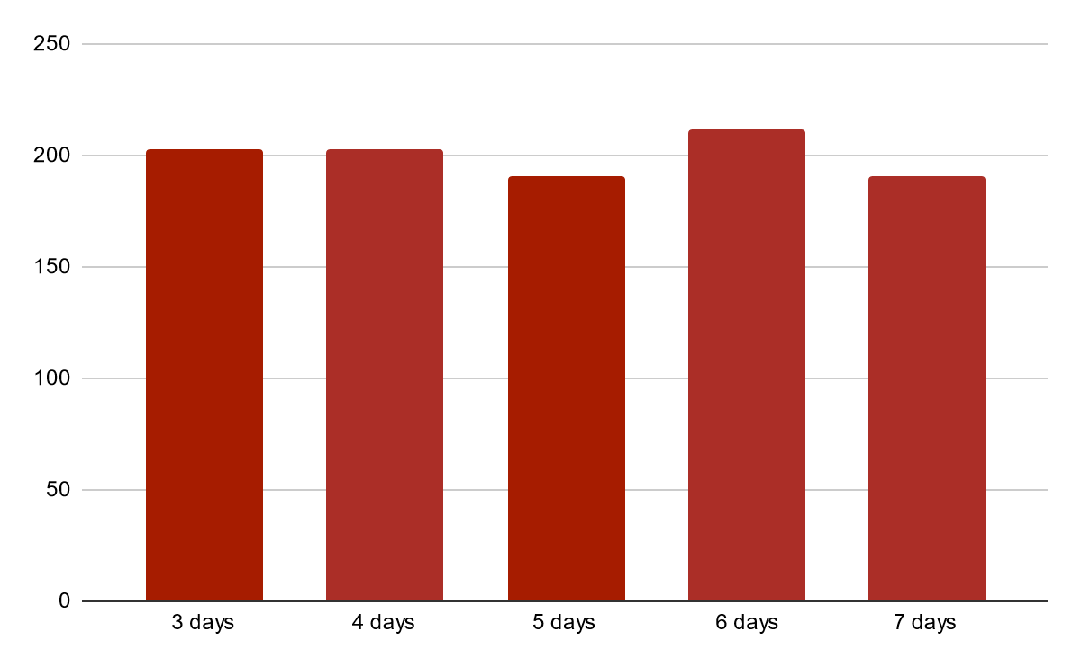
What was the average rental duration for all videos?
2
● AVERAGE RENTAL IS 5 DAYS ● MOST MOVIES ARE RENTED FOR 6 DAYS

Slide 9


3 Which countries are Rockbuster customers based in?
4 Do sales figures vary between geographic regions?
TURKEY
RUSSIA
USA
15 customers
1498.49 $
28 customers
2765.62 $
JAPAN
36 customers
3685,31 $
31 customers
3122,51 $
MEXICO
CHINA
30 customers
2984,82 $
53 customers
5251,03 $
BRAZIL
INDIA
PHILIPPINES
28 customers
2919,19 $
60 customers
6034,78 $
20 customers
2219.70 $
INDONESIA
14 customers
1352,69 $

Slide 10
Where are customers with a high lifetime value based?
5
ID | Name |  | Country | City | Amount
225 | Arlene | Harvey | India | Ambattur | 111,76$
424 | Kyle | Spurlock | China | Shanwei | 109,71$
240 | Marlene | Welch | Japan | Iwaki | 106.77$
486 | Glen | Talbert | Mexico | Acua | 100.77$
537 | Clinton | Buford | USA | Aurora | 98.76$
14 | Betty | White | USA | Citrus Heights | 96.77$
443 | Francisco | Skidmore | Brazil | So Leopoldo | 93.79$
249 | Dora | Medina | China | Tianjin | 88,81$
411 | Norman | Currier | Indonesia | Cianjur | 73,76$
350 | Juan | Fraley | Russia | Teboksary | 63,79$

Slide 11
Insights & Recommendations
Leverage High Revenue Movies:
Enhance marketing and promotional efforts for top-performing movies to boost revenue further.
Adjust Rental Durations:
Considering the average rental duration of 5 days and the most frequent rental duration of 6 days, offer flexible rental periods ranging from 3 to 7 days. This can better meet diverse customer needs and potentially increase rental frequency.
Optimize Geographic Strategies:
Focus on Asian Market. 5 out of 10 top countries by revenue and clients are Asians. Develop targeted marketing campaigns and tailor content to suit the preferences and viewing habits of customers in these region to enhance engagement and revenue growth
Focus on High Value Markets:
Direct marketing strategies towards countries with high lifetime value customers to maximize returns.

Slide 12
THANKS!
Does anyone have any questions?

